Slide 1
— Project —
Dual-Point Machinery Condition Monitoring Using Triaxial Vibration Sensing and Global Shutter Vision
Team Leader:YE Bingli
Team Members: ZHANG Zhanshuo, GAN Yunxuan, HE Xinhao, ZHANG Jiaxin, YANG Zhe, YANG Xuanzhi

Slide 2
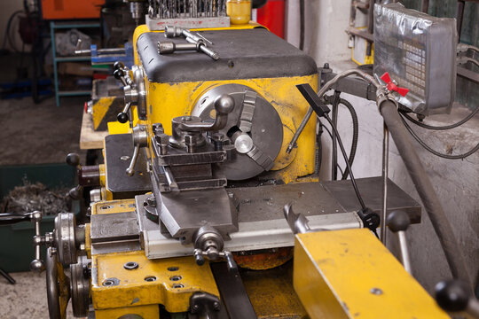
01
Topic Introduction
This project addresses the typical industrial problem of operating condition monitoring for mechanical equipment. During long-term operation, equipment such as rotating machinery, machine tools, engines and bearings may exhibit changes in vibration characteristics due to imbalance, looseness, wear, insufficient lubrication or varying operating conditions. Failure to identify anomalies in a timely manner can easily lead to unplanned downtime, increased maintenance costs, production interruptions, and even safety accidents. Therefore, identifying the operating status of equipment based on vibration information is one of the core issues in predictive maintenance and intelligent operation and maintenance.

Slide 3
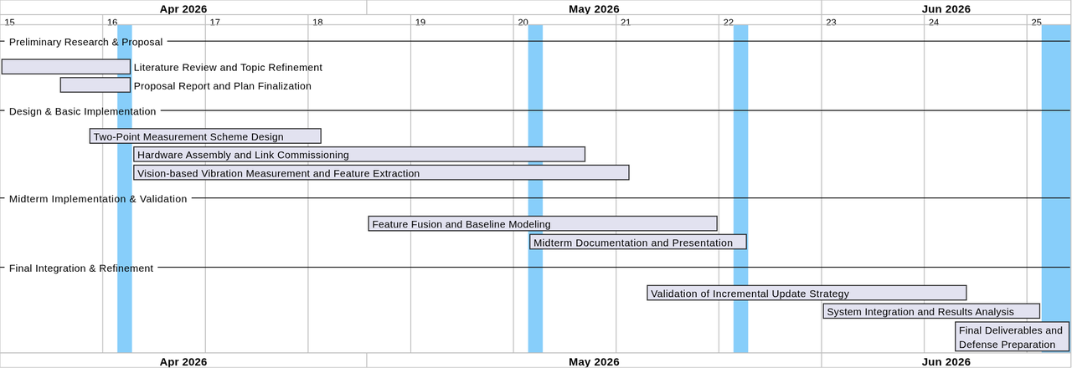
02
Research Schedule
Thesis proposal, preliminary system scheme
Prototype code, data acquisition scheme, phased data
Mid-term presentation, experimental results
Final project report, defense PPT, demonstration system
Investigation & Proposal
Preliminary research and scheme design finished.
Mid-term Implementation
Hardware procurement, dual-point coding, data collection, baseline modeling.
Later-stage Integration
Incremental update, system test, result analysis, final report preparation.

Slide 4
03
Research Objectives
Object | Corresponding achievements
Build a dual-measurement point monitoring link | Complete the prototype of "three-axis sensor + global camera" acquisition and synchronous analysis
Establish the main link for visual vibration measurement | Output the ROI corner point trajectory, median displacement timing, and visual features such as the sliding window main frequency, power, spectral centroid, and spectral entropy
Implement the state recognition model | Complete the single-modal baseline and dual-modal fusion classification experiments
Verify the incremental update capability | Complete prototype updates or lightweight online update demonstrations based on a small number of new samples
Complete the course delivery | Form the materials for the proposal, mid-term and conclusion, as well as a demonstrable system

Slide 5
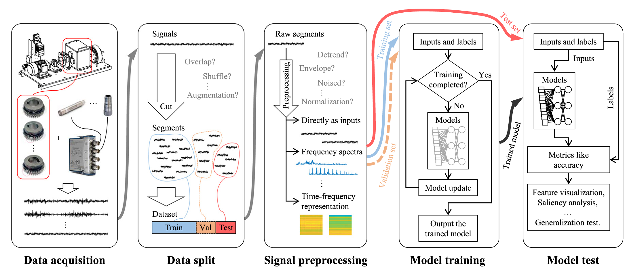
04
Research Ideas

Slide 6
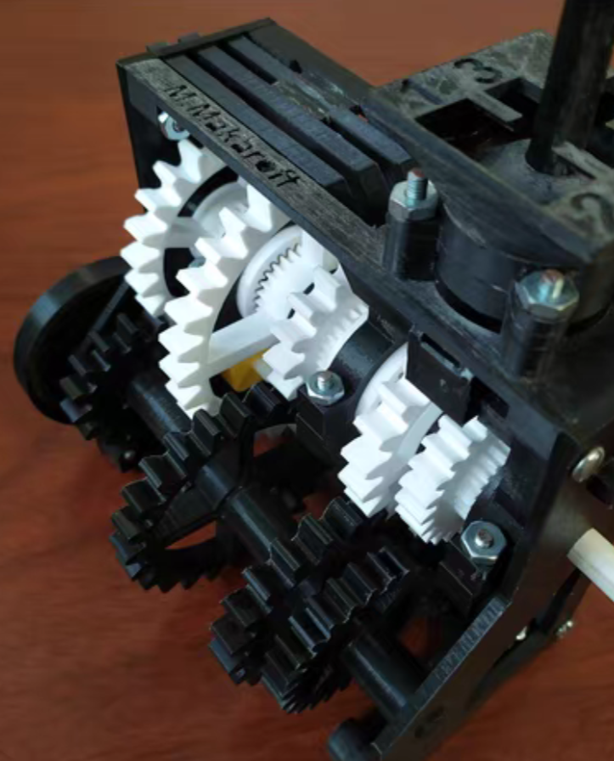
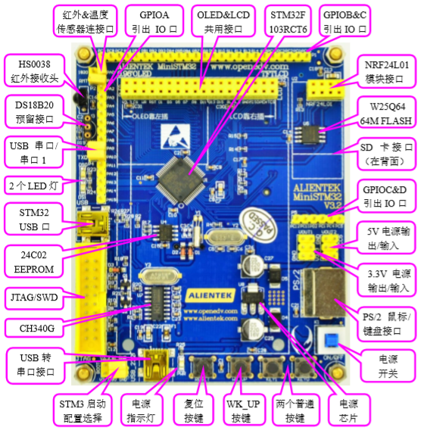
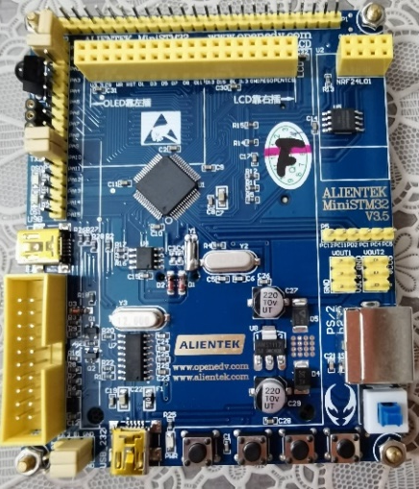
04
Research Ideas
齿轮箱模型
STM32开发板
Gearbox Model
STM32

Slide 7
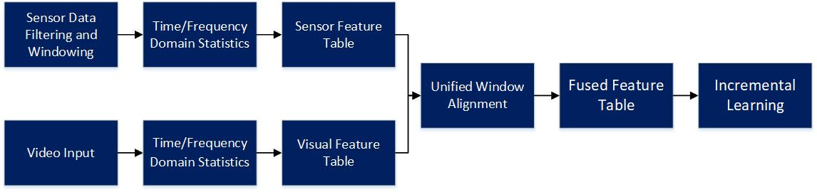
05
Proposed Scheme

Slide 8
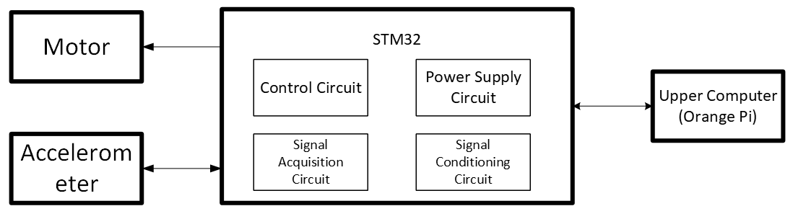
05
Proposed Scheme
Control, Power
Input digital signal
Input
Control, Signal Processing
Control, Power

Slide 9
06
Feasibility Analysis
Dimension | Feasibility Description | Current Risks | Countermeasures
Visual Vibration Sensing | Corner tracking – displacement reconstruction – sliding-window Welch features” pipeline is in place, with a clear structure for structured-feature output | Significantly affected by lighting, texture, frame rate, and optical-flow drift | Select a stable ROI with sufficient texture and lighting; record the true sampling rate; use multi-point statistics and windowed analysis to suppress anomalies
Fusion Recognition | Feature engineering + classical machine learning is well-suited for a small-sample course project | Dual-modal synchronization and label management are complex | Adopt a unified time window and sample-ID management
Incremental Update | Low implementation barrier for prototype updates and lightweight online learning | Instability when samples for new operating conditions are too few | Start with demo-level validation, then restrict the range of operating conditions
Resources | Mechanical test rig, 3-axis accelerometer, global-shutter camera, STM32, Orange Pi / host PC, and standard dev environment. | Low | Use mature hardware and open-source algorithm libraries
Timeline | Web, hardware, and algorithm developed in parallel; prototype + staged validation | Complex models may lead to long implementation and training times | Use interpretable, low-cost classical ML with a lightweight incremental-learning scheme

Slide 10
07
Personnel Division
Name | Task Assignment
YANG Xuanzhi | Model training
GAN Yunxuan | Hardware
YE Bingli | Connecting with teachers, back-end driver, camera data collection
HE Xinhao | Web frontend and backend
YANG Zhe | Hardware
ZHANG Zhanshuo | Visual data processing
ZHANG Jiaxin | Document writing and testing

Slide 11
08
Budget
No. | Name | Price | Total
1 | STM32 Development Board | 242RMB | 810.95RMB
2 | SG90 Servo Module | 9.8RMB
3 | MB018 Accelerometer Module | 9.8RMB
4 | MB010 Relay Module | 9.8RMB
5 | MS6DSV Accelerometer Sensor | 26.2RMB
6 | STM32 Minimum System Board | 68.6RMB
7 | Motor Gear Kit | 27.35RMB
8 | N20 DC Gear Motor | 19.5RMB
9 | Motor Model | 9.9RMB
10 | USB 3.0 Industrial Global Shutter Camera | 388RMB

Slide 12
— Project —
20XX年度
Thanks

